Slide 1
Graphics Systems and Models
Chun-Yuan Lin
CG
115/11/08

Slide 2
In this Chapter
Computer Graphics is concerned with all aspect of producing pictures or image using a computer.
We start our journey with a short discussion of applications of computer graphics.
Our approach is top-down to stresses the relationships between computer graphics and image formation by familiar methods, such as drawing by hand and photography.
OpenGL, which has become a widely accepted standard for developing graphics applications.
CG
115/11/08

Slide 3
Applications of Computer Graphics (1)
The applications of computer graphics are many and varied; we can, however, divide them into four major area:
  Display of information
  Design
  Simulation and animation
  User interfaces.
Display of information
  Supercomputers now allow researchers in many areas to solve previously intractable problems.
CG
115/11/08

Slide 4
Applications of Computer Graphics (2)
Design
  Professions such as engineering and architecture are concerned with design.
Simulation and Animation
User Interfaces
CG
115/11/08

Slide 5
A Graphics System (1)
There are five major elements in a graphics system.
  Input devices
  Processor
  Memory
  Frame buffer
  Output devices
Pixel and the Frame Buffer
  A picture is produced as an array-the raster-of picture elements, or pixels, within the graphics system.
  The pixels are stored in a part of memory called the frame buffer.
CG
115/11/08

Slide 6
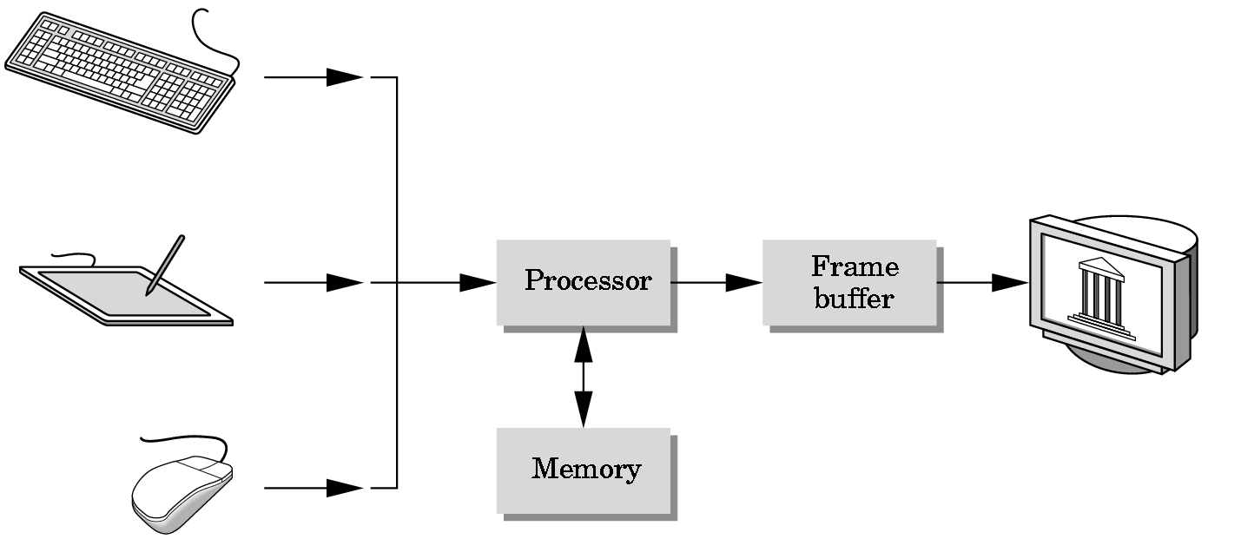
Basic Graphics System
Output device
Input devices
Image formed in FB
Angel: Interactive Computer Graphics 5E © Addison-Wesley 2009

Slide 7
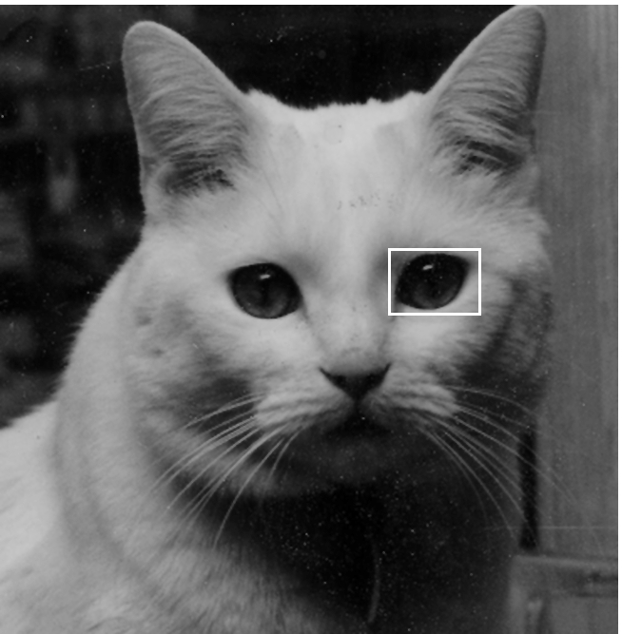
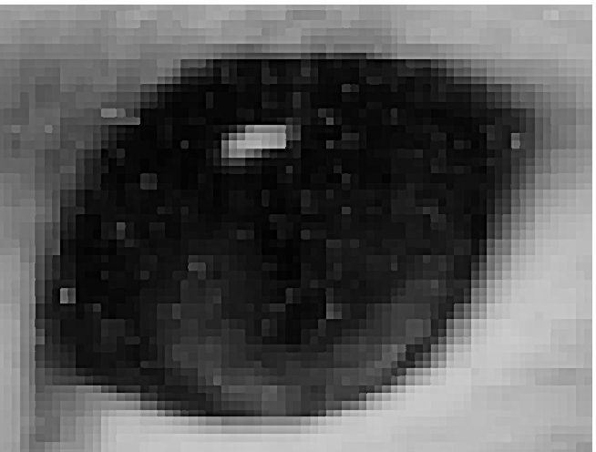
Raster Graphics
Image produced as an array (the raster) of picture elements (pixels) in the frame buffer
Angel: Interactive Computer Graphics 5E © Addison-Wesley 2009

Slide 8
A Graphics System (2)
  High dynamic range applications require more than 24-bit fixed point color representations of RGB colors.
  Some recent frame buffers store RGB values as floating-point numbers in standard IEEE format.
  In a simple system, there may be only one processor, CPU of the system, which must do both the normal processing and the graphical processing.
    The main graphical function of the processor is to take specifications of graphical primitives (such as line, circles, and polygons) generated by application programs and to assign values to the pixels in the frame buffer that best represent these entities.
    A triangle is specified by its three vertices, but to display its outline by the three line segments connecting the vertices.
CG
115/11/08

Slide 9
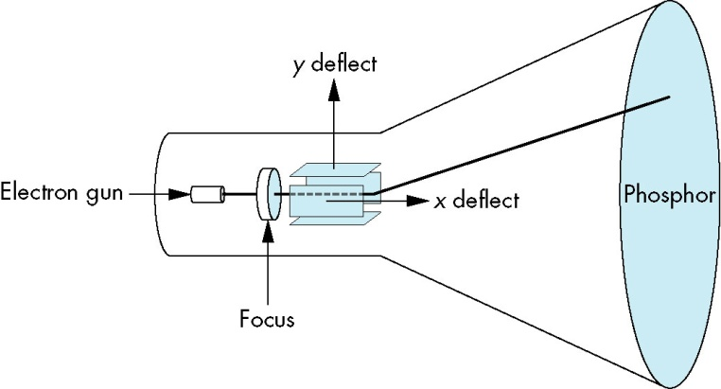
A Graphics System (3)
  Today, virtually all graphics systems are characterized by special-purpose graphics processing units (GPU), custom-tailored to carry out specific graphics functions.
Output Devices
  For many years, the dominant type of display (or monitor) has been the CRT.
Input Devices
  Most graphics systems provides a keyboard and at least one other input devices (mouse).
CG
115/11/08

Slide 10
Images: Physical and Synthetic (1)
The traditional pedagogical approach to teaching computer graphics has been focused on how to construct raster images of simple two-dimensional geometric entities.
Next, most textbooks discussed how to define two- and three-dimensional mathematical objects in the computer and image them with the set of two-dimensional rasterized primitives.
We want to exploit the capabilities of the software and hardware to create realistic images of computer-generated three-dimensional object. (supported directly by most present computer graphics systems)
CG
115/11/08

Slide 11
Images: Physical and Synthetic (2)
Computer-generated images are synthetic or artificial, in the sense that the objects being imaged may not exist physically.
Before, we discuss the mechanics of writing programs to generate images, we discuss the way images are formed by optical systems.
In this chapter, we make minimal use of mathematics. We want to establish a paradigm for creating images and to present a computer architecture for implementing that paradigm.
CG
115/11/08

Slide 12
Images: Physical and Synthetic (3)
Objects and Viewers
  We live in a world of three-dimensional objects.
  Two basic entities must be part of any image-formation process, be it mathematical or physical: object and viewer.
  In computer graphics, where we deal with synthetic objects, we form objects by specifying the position in space of various geometric primitives, such as points, lines, and polygons. In most graphics systems, a set of locations in space, or of vertices, is sufficient to define, or approximate, most objects.
  Every imaging system must provides a means of forming images from objects. To form an image, we must have someone or something that is viewing our objects, be it a person, a camera, or a digitizer.
CG
115/11/08

Slide 13
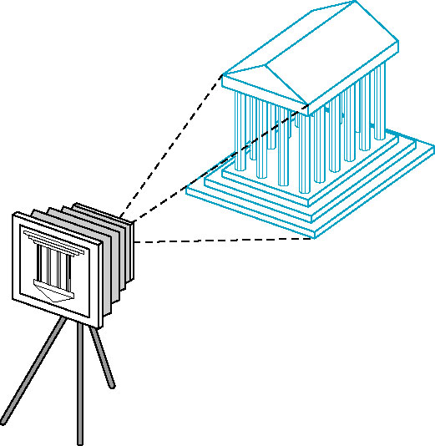
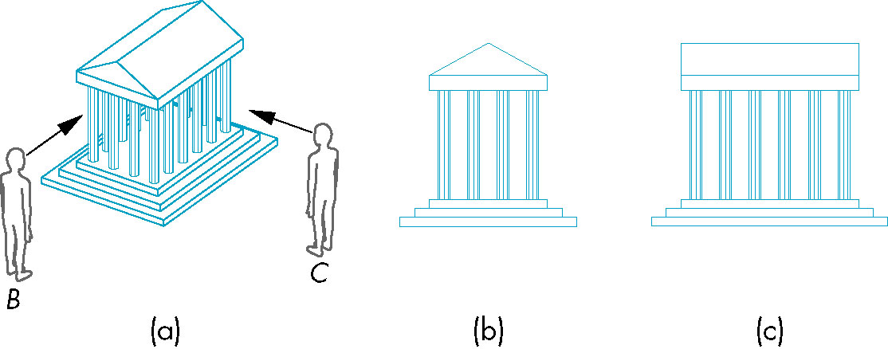
Images: Physical and Synthetic (4)
  It is the viewer that forms the image of our objects.
  However, the image that they define-what we find on the film plane-is two dimensional. (specification of the object is combined with the specification of the viewer to produce a two-dimensional image)
CG
115/11/08

Slide 14
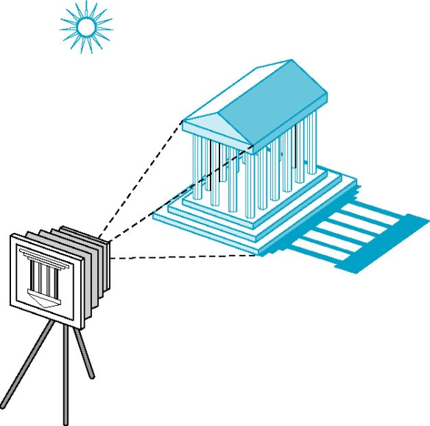
Images: Physical and Synthetic (5)
Light and Images
  If there were no light sources, the objects would be dark, and there would be nothing visible in our image.
  Taking a more physical approach, we can start with the arrangement shown below, which shows a simple physical image system.
  Light is a form of electromagnetic radiation.
  Electromagnetic energy travels as waves that
  be characterized by either their wavelengths
  or their frequences.
  This visible spectrum, which has wavelengths
  in the range of 350 to 780 nanometers (nm),
  is called (visible) light.
CG
115/11/08

Slide 15
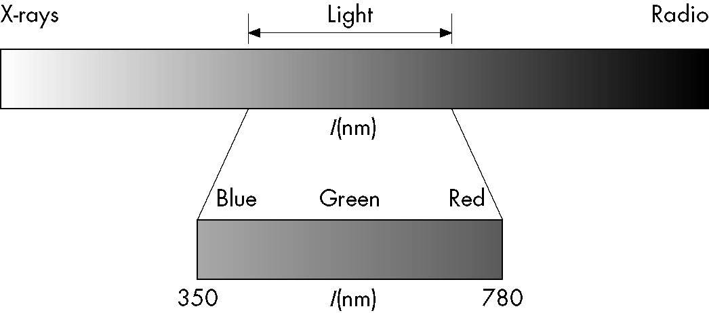
Images: Physical and Synthetic (6)
  A given light source has a color determined by the energy that it emits at various wavelengths.
  Light sources can emit light either as a set of discrete frequencies or continuously.
  We can follow a more traditional path that is correct when we are operating sufficiently high light levels and at a scale where the wave nature of light is not a significant factor.
  Geometric optics models
  light sources as emitters of
  light energy, each of which
  have a fixed intensity.
CG
115/11/08

Slide 16
Images: Physical and Synthetic (7)
  Modeled geometrically, light travels in straight line, from the sources to those objects with which it interacts.
  An ideal point source emits energy from a single location at one or more frequencies equally in all directions.
  We consider only point sources for now.
Image Formation Models
  There are multiple approaches to how we can form images from a set of objects, the light-reflecting properties of those objects, and the properties of the light sources in the scene.
  In this section, we introduce two physical approaches. (but are not suitable for real-time graphics)
CG
115/11/08

Slide 17
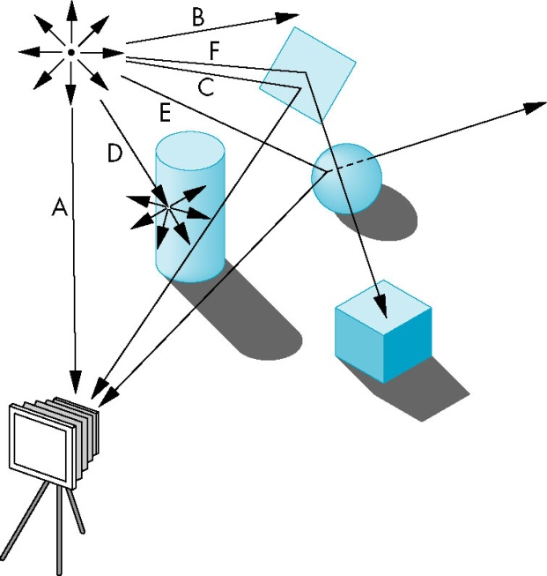
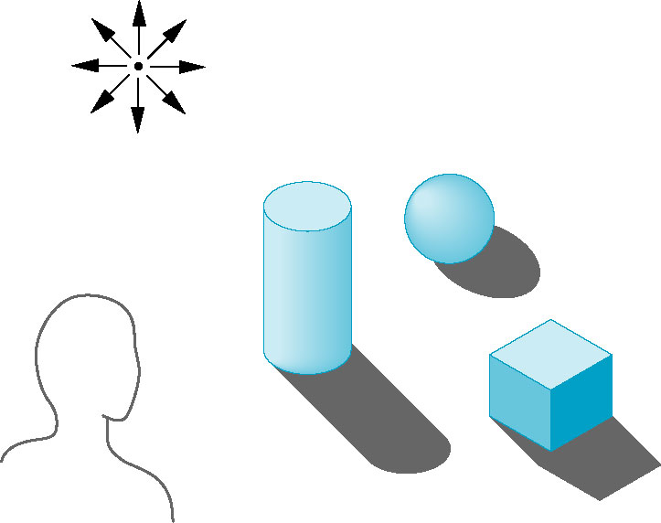
Images: Physical and Synthetic (8)
  We can start building an image model by following light from a source. (single point source)
  We include the viewer in the figure because we are interested in the light that reaches her eye.
  A ray is a semi-infinite line that emanates from a point and travels to infinity in a particular direction.
CG
115/11/08

Slide 18
Images: Physical and Synthetic (9)
  These rays can interact with the object’s surfaces in a variety of ways.
  Ray tracing and photon mapping are image-information techniques that are based on the ideas and that can form the basis for producing computer-generated images.
  Although tracing rays can provide a close approximation to the physical world, it is not well suited for real-time computation. (parallel)
  Other physical approaches to image formation are based on conservation of energy. The most important in computer graphics is radiosity.
  Given the time constrains in image formation by real time graphics, we usually are satisfied with image that look reasonable rather than image that are physically correct. (with the increased speed of present hardware, we can get closer to physically correct images in real time systems)
CG
115/11/08

Slide 19
Imaging Systems (1)
We now introduce two physical imaging system: the pinhole camera an the human visual system.
The pinhole camera is a simple example of an imaging system that will enable us to understand the functioning of cameras and of other optical imagers.
The human visual system is extremely complex but still obeys the physical principles of other optical imaging systems. (help us to exploit the capability of computer-graphics systems)
CG
115/11/08

Slide 20
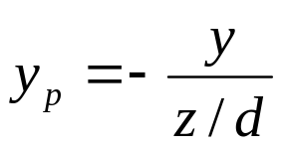
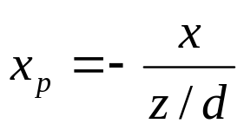
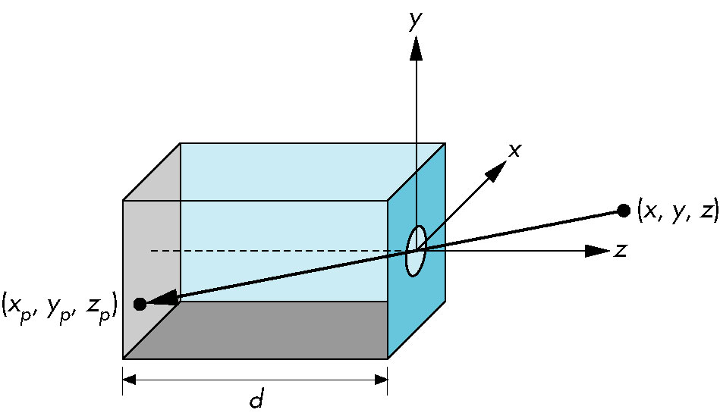
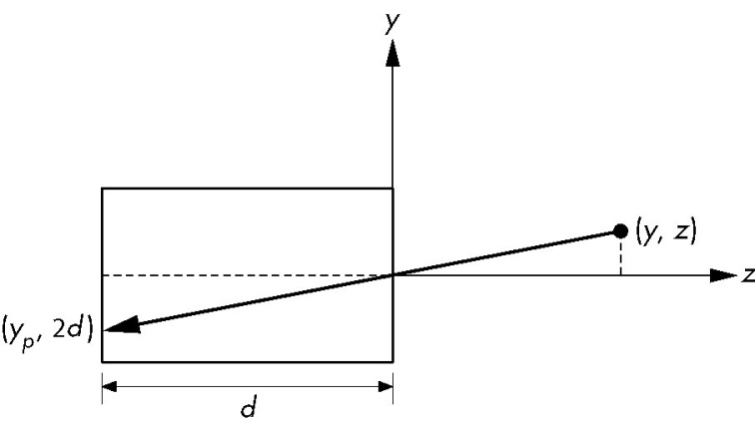
Imaging Systems (2)
The Pinhole Camera
  The pinhole camera shown in Figure below provides an example of image formation that we can understand with a simple geometric model.
CG
115/11/08

Slide 21
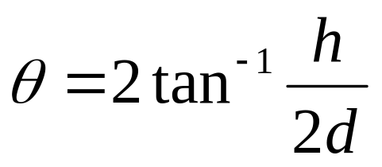
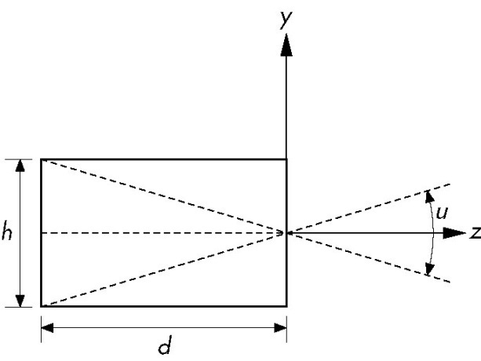
Imaging Systems (3)
  The point (x_{p}, y_{p}, -d) is called the projection of the point (x, y, z).
  Note that all points along the line between (x, y, z) and (x_{p}, y_{p}, -d) project to (x_{p}, y_{p}, -d) so that we cannot go backward from a point in the image plane to the point that produce it.
  In the idealized model, the color on the film plane at this point will be the color of the point (x, y, z).
  The field, or angle, of view of the camera is the angle made by the largest object that the camera can image on its film plane.
CG
115/11/08

Slide 22
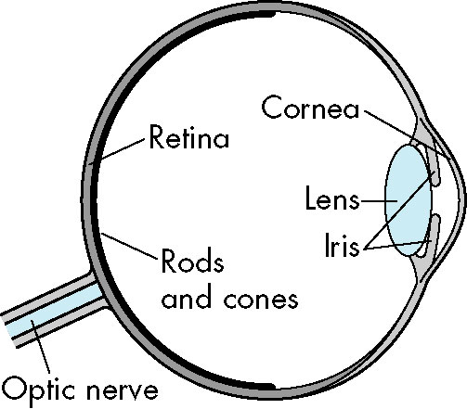
Imaging Systems (5)
The human visual system
  Our extremely complex visual system has all the components of a physical imaging system.
  Resolution is a measure of what size objects we can see. More technically, it is a measure of how close we can place two points and still recognize that there are two distinct point.
  Brightness is a measure of how intense we perceive the light emitted from an object to be. Brightness is an overall measure of how we react to the intensity of light.
  The initial processing of light in the human visual system is based on the same principles used by most optical systems. (much more complex than that of a camera or telescope)
  The final processing is done in a part of brain called the visual cortex, where high-level functions, such as object recognition, are carried out.
CG
115/11/08

Slide 23
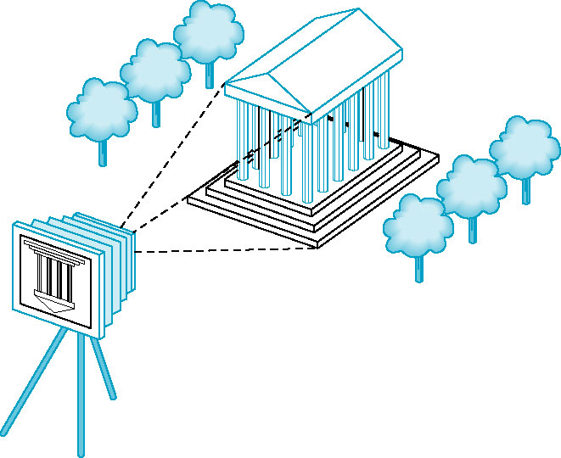
The Synthetic-Camera Model (1)
We look at creating a computer-generated image as being similar to forming an image using an optical system. This paradigm has become known as the synthetic-camera model.
So that we can emulate this process to create artificial images, we need to identify a few basic principles.
CG
115/11/08

Slide 24
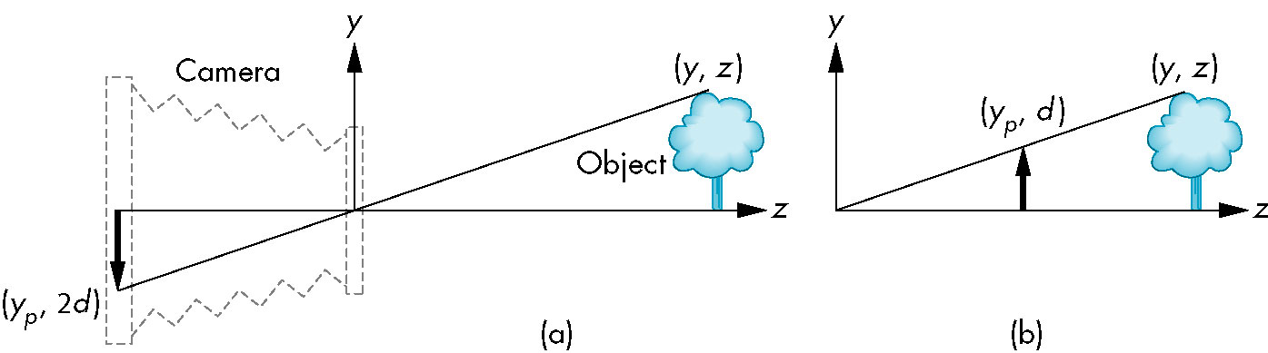
The Synthetic-Camera Model (2)
First, the specification of the objects is independent of the specification of the viewer. (within a graphics library, there will be separate functions for specifying the objects and the viewer)
Second, we can compute the image using simple geometric calculations, just as we did with the pinhole camera.
CG
115/11/08

Slide 25
The Synthetic-Camera Model (3)
With the synthetic camera we can avoid flipping by a simple trick.
We draw another plane in front of the lens, and work in three dimensions.
We find the image of a point on the object on the virtual image plane by drawing a line, called a projector, from the point to the center of the lens, or the center of projection (COP).
The virtual image plane that we have moved in front of the lens is called the projection plane.
CG
115/11/08

Slide 26
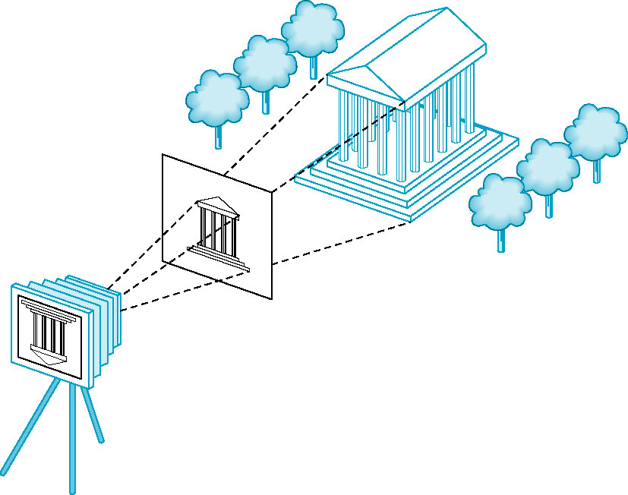
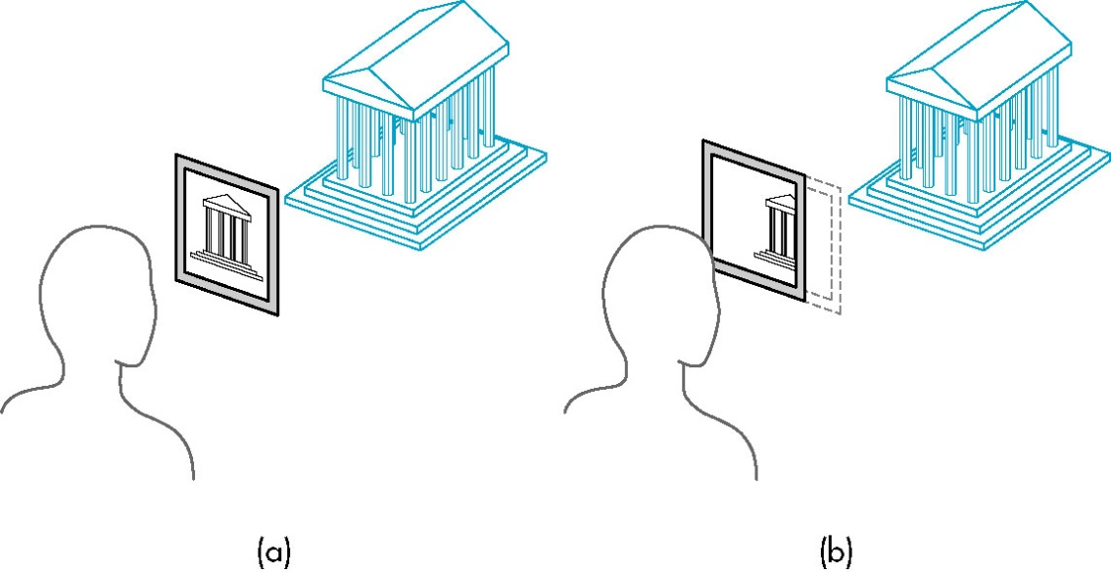
CG
115/11/08

Slide 27
The Synthetic-Camera Model (4)
Not all objects can be imaged onto the pinhole camera’s film plane.
The angle of view expresses this limitation. In the synthetic camera, we can move this limitation to the front by placing a clipping rectangle, or clipping window.
CG
115/11/08

Slide 28
The Programmer’s Interface (1)
There are numerous ways that a user can interact with a graphics system.
The interface between an application program and a graphics system can be specified through a set of functions that resides in a graphics library. These specification are called the application programmer’s interface (API).
The software drivers are responsible for interpreting the output of the API and converting these data to a form that is understood by the particular hardware.
CG
115/11/08

Slide 29
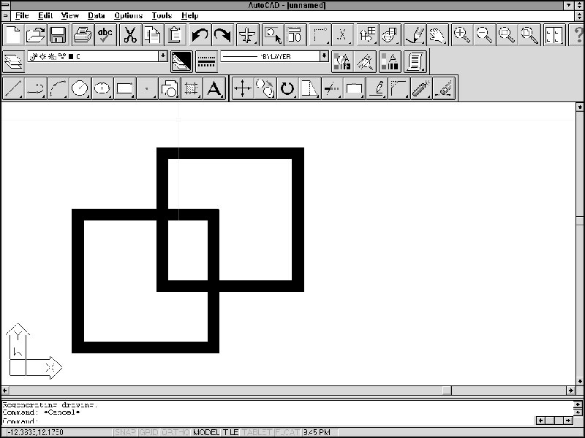
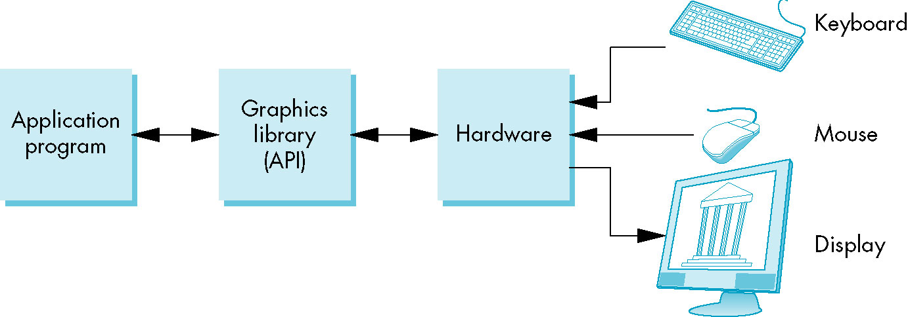
CG
115/11/08

Slide 30
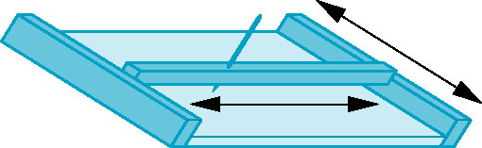
The Programmer’s Interface (2)
The pen-plotter model
  Most early graphics systems were two-dimensional systems.
  The conceptual model that they used is now referred to as the pen-plotter model.
  A pen-plotter produces images by moving a pen held by a gantry, a structure that can move the pen in two orthogonal directions across the paper.
  We can describe such a graphics system with the following drawing functions. (draw a line from the old to the new location of the pen)
  moveto (x, y)
  lineto (x, y)
CG
115/11/08

Slide 31

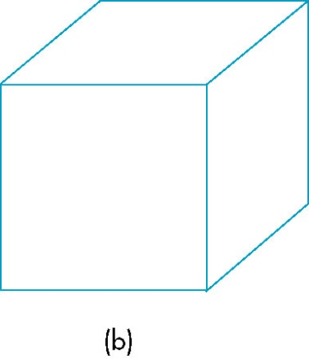
The Programmer’s Interface (3)
  Here is a fragment of a simple program in such a system.
moveto (0, 0);
lineto (1, 0);
lineto (1, 1);
lineto (0, 1);
lineto (0, 0);
  Another program: (follow the above program)
moveto (0, 1);
lineto (0.5, 1.866);
lineto (1.5, 1.866);
lineto (1.5, 0.866);
lineto (1, 0);
moveto (1, 1);
lineto (1.5, 1.866);
CG
115/11/08

Slide 32
The Programmer’s Interface (4)
  Two dimensional model relies on writing pixels directly into a frame buffer.
write_pixel (x, y, color)
  We are much more interested, however, in the three-dimensional world. The pen-plotter model does not extend well to three-dimensional graphics system. (projection) (understanding projection is crucial to understanding three-dimensional grpahics)
  However, to use an API that allows users to work directly in the domain of their problems and to use computers to carry out the details of the projection process automatically.
CG
115/11/08

Slide 33
The Programmer’s Interface (5)
Three-dimensional APIs
  The synthetic-camera model is the basis for all the popular APIs, including OpenGL, Direct3D, and Open Scene Graph.
  We need the following functions in the API to specify
    Objects
    A viewer
    Light sources
    Material properties
  Objects are usually defined by sets of vertices. For more complex objects, there may be multiple ways of defining the object from a set of vertices.
CG
115/11/08

Slide 34
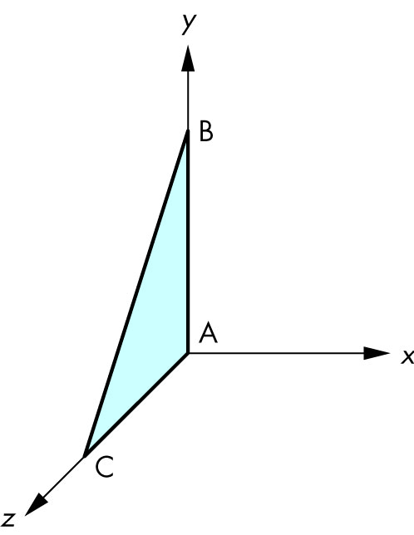
The Programmer’s Interface (6)
  Most APIs provide similar sets of primitive objects for the users. These primitives are usually those that can be displayed rapidly on the hardware.
  OpenGL programs define primitives through lists of vertices.
  A triangular polygon:
  glBegin (GL_POLYGON)
  glVertex3f (0.0, 0.0, 0.0);
  glVertex3f (0,0, 1.0, 0.0);
  glVertex3f (0.0, 0.0, 1.0);
  glEnd();
CG
115/11/08

Slide 35
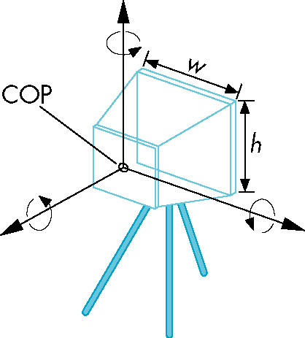
The Programmer’s Interface (7)
  We can specify a viewer or camera in a variety of ways. Available APIs differ in how much flexibility they provide in camera selection and in how many different methods they allow. (four types)
    Position
    Orientation
    Focal length: The focal length of the lens determines the size of the image on the film plane.
    Film plane: The back of the camera has a height and a width.
CG
115/11/08

Slide 36
The Programmer’s Interface (8)
  These specification can be satisfied in various ways. One way to develop the specifications for the camera location and orientation uses a series of coordinate system transformation. (this approach is useful, both for implementing and for getting the full set of views that a flexile camera can provide)
  Having many parameters to adjust, however, cam also make it difficult to get a desired image. (Classical viewing techniques stress the relationship between the object and the viewer) (non of the APIs built on the synthetic-camera model provide functions for directly specifying a desired relationship between the camera and an object)
  gluLookAt (cop_x, cop_y, cop_z, at_x, at_y, at_x, up_x, up_y, up_z);
  glPerspective (field_of_view, aspect_ratio, near, far);
CG
115/11/08

Slide 37
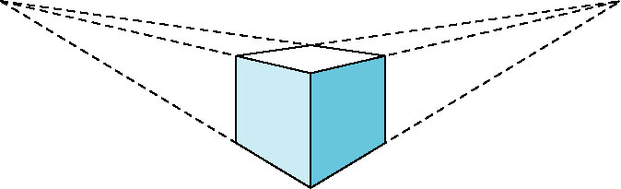
The Programmer’s Interface (9)
  Light sources are defined by their location, strength, color, and directionality. APIs provides a set of functions to specify these parameters for each source.
  Material properties are characteristics, or attributes, of the objects, and such properties are specified through a series of function calls at the time that each object is defined.
  Both light sources and material properties depend on the models of light-material interactions supported by the API.
CG
115/11/08

Slide 38
The Programmer’s Interface (10)
A Sequence of Images
  In Chapter 2, we begin our detailed discussion of the OpenGL API.
  In Chapters 2 and 3, we will show you how to generate images composed of simple geometric objects-points, line segments, etc.
  In Chapter 4 and 5, you will learn how to transform objects in three dimensions and how to obtain a desired three-dimensional view of a model with hidden surfaces removed.
  In Chapter 6, we will discuss the light-material models.
CG
115/11/08

Slide 39
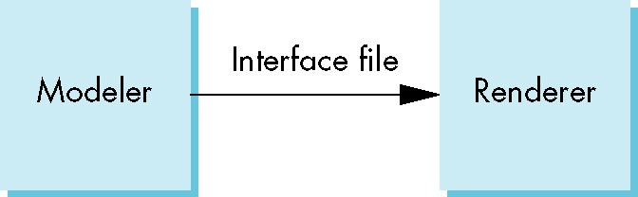
The Programmer’s Interface (11)
The Modeling-Rendering Paradigm
  Movies, we can separate the modeling of the scene from the production of the images or the rendering of the scene.
  We might implement the modeler and the rendering with different software and hardware. We first want to design and position our objects. Consequently, we prefer to carry out this step on an interactive workstation with good graphics hardware.
  The interface between the modeler and renderer can be as simple as a file produced by the modeler that describes the objects and that contains additional information important only to the renderer.
CG
115/11/08

Slide 40
The Programmer’s Interface (12)
  One of the advantage of this approach is that it allows us to develop modelers that although they use the same renderer, are tailored to particular applications.
  This paradigm has become popular as a method for generating computer games and images over the internet.
CG
115/11/08

Slide 41
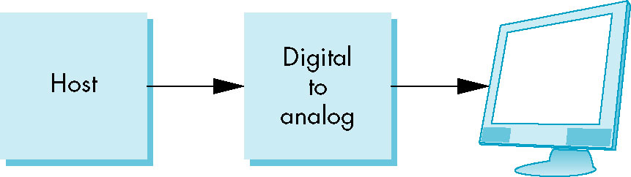
Graphics Architectures (1)
On one side if the API is the application program.
On the other side is some combination of hardware and software that implements the functionality of the API.
Researchers have taken various approaches to developing architectures to support graphics APIS. Early graphics systems used general-purpose computers with the standard von Neumann architecture.
CG
115/11/08

Slide 42
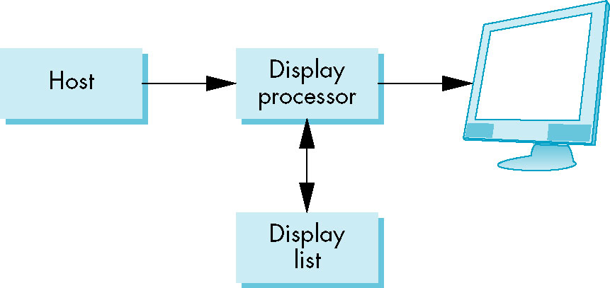
Graphics Architectures (2)
Display Processors
  The earliest attempts to build special-purpose graphics systems were concerned primary with relieving the general-purpose computer from the task of refreshing the display continuously.
  These display processors had conventional architectures but included instructions to display primitives on the CRT.
CG
115/11/08

Slide 43
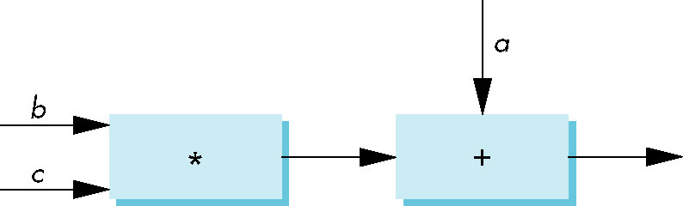
Graphics Architectures (3)
Pipeline Architecture
  The major advances in graphics architectures closely parallel the advances in workstation.
  The concept of pipeline is illustrated in Figure below.
The same computation with many values of a, b and c
CG
115/11/08

Slide 44
Graphics Architectures (4)
The Graphics Pipeline
  We start with a set of objects. Each object comprises a set of graphical primitives. Each primitive comprises a set of vertices.
  We can think of the collection of primitive types and vertices as defining the geometry of the scene.
  In a complex scene, there may be thousands-even millions-of vertices that define the objects.
  Four major steps in the imaging process.
    Vertex processing
    Clipping and primitive assembly
    Rasterization
    Fragment processing
CG
115/11/08

Slide 45
Graphics Architectures (5)
Vertex Processing
  In the first block of our pipeline, each vertex is proposed independently.
  The two major functions of this block are to carry out coordinate transformation and to compute a color for each vertex.
  Many of the steps in the imaging process can be viewed as transformation between representations of objects in different coordinate systems.
  Eventually, after multiple stages of transformation, the geometry is transformed by a projection transformation.
CG
115/11/08

Slide 46
Graphics Architectures (6)
  The assignment of vertex colors can be as simple as the program specifying a color or as complex as the computation of a color from a physically realistic lighting model that incorporates the surface properties of the object and the characteristic light sources in the scene.
Clipping and Primitive Assembly
  We must do clipping because of the limitation that no imaging system can see the whole world at once.
  We must assemble sets of vertices into primitives, such as line segments and polygons.
CG
115/11/08

Slide 47
Graphics Architectures (7)
Rasterization
  The primitive that emerge from the clippers are still represented in terms of their vertices and must be processed to generate pixels in the frame buffer. If three vertices specify a triangle filled with a solid color, the rasterizer must determine which pixels in the frame buffer are inside the polygon.
  The output of the rasterizer is a set of fragments for each primitive.
Fragment Processing
  The final block in our pipeline takes in the fragments generated by the rasterizer and updates in the pixels in the frame buffer.
  If the applications generated three-dimensional data, some fragments may not be visible because the surfaces that they define, are behind other surfaces.
CG
115/11/08

Slide 48
Programmable Pipelines
Graphics architecture have gone through multiple cycles in which the importance of special purpose hardware relative to standard CPUs has gone back and forth.
None of the other approaches-ray tracing, radiosity, photon mapping-leads of real-time performance.
The commodity graphic market is dominated by graphics cards that have pipelines built into graphics processing unit.
CG
115/11/08

Slide 49
Performance Characteristics (1)
There are two fundamentally different types of processing in our pipeline architecture.
  At the front end, there is geometric processing, based on processing vertices through the various transformation, vertex shading, clipping and primitive assembly. This processing is ideally suited for pipeline, and it usually involves floating point calculations.
    The geometry engine developed by Silicon Graphics Inc. (SGI) was a VLSI implementation for many of these operations in a special-purpose chip.
    Today, graphics workstations and commodity graphics cards uses graphics processing units (GPUs) that perform most of the graphics operations at the chip level.
CG
115/11/08

Slide 50
Performance Characteristics (2)
  Beginning with rasterization and including many features that we discuss later, processing involves a direct manipulation of bits in the frame buffer. This back-end processing is fundamentally different from front-end processing and we implement it most effectively using architecture that have the ability to move blocks of bit quickly.
    The fastest graphics workstations are characterized by one or more geometric pipeline at the front ends and parallel bit processors at the back ends.
    GPUs that contain the entire pipeline within a single chip.
CG
115/11/08

